Slide 1


Python Project with Pandas v.2 Food
DATA ANALYSIS
Mirko Rossi

Slide 2
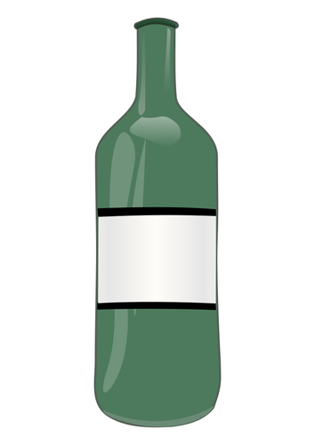


Introduction
Wine is a highly appreciated product in Italy and internationally, making it an excellent investment for aspiring entrepreneurs.
To start an e-commerce, you must have a carefully selected list of wines among the tens of thousands of existing types.
Concentrating on a specific number and types of wine can ensure a high turnover in the warehouse and short return times on the invested capital.
This project aims to produce a catalogue of wines from small producers using a dataset of approximately 130,000 wines.

Slide 3





Introduction
The public wine dataset, in CSV format, is available on Kaggle.
I used Jupyter as a development environment and the Pandas, SeaBorn, and Matlplotlib libraries.
The work was divided into three phases:
Data Cleaning
Data Analysis and Visualisation
Creation of the Catalogue

Slide 4
Data Cleaning

Slide 5
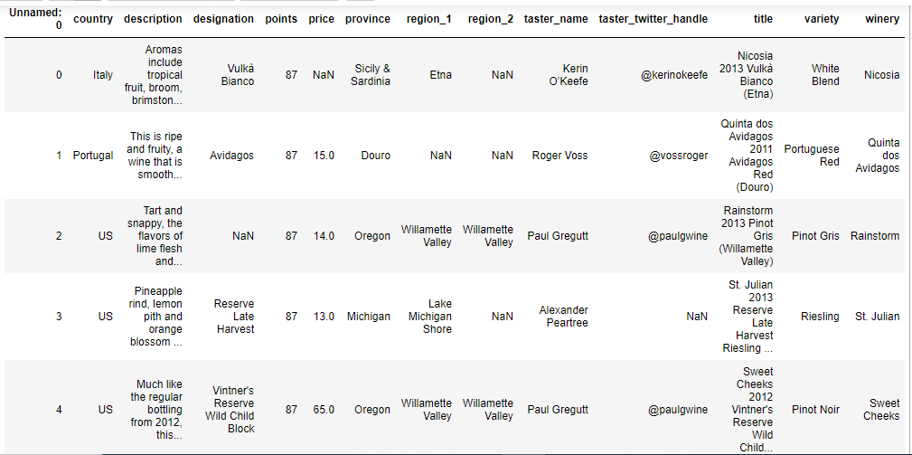
Study of the dataset - head method

Slide 6
Study of the dataset - head method
Data Cleaning first requires understanding the content of the field under study.
You can observe the presence of redundant columns (Unnamed: 0, region_2) or non-essential columns for catalogue purposes (taster_name, taster_twitter_handle), along with null values in the price field, which is fundamental for creating the catalogue.

Slide 7
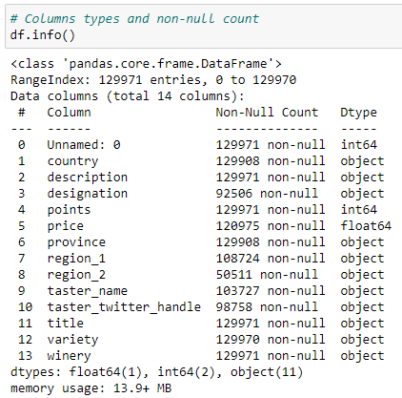
Study of the dataset - info method
The info method returns a list of field labels, which integrates with the observation that can be made by the head method.
You can observe that the 129,971 rows have empty fields which percentage can be calculated.

Slide 8
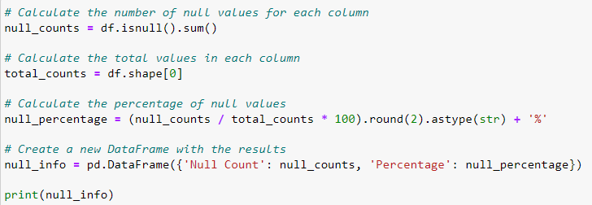
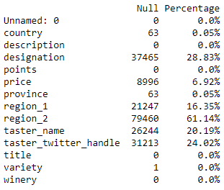
Study of the dataset - percentage of null values
Since the country and price fields are fundamental for creating a catalogue, all records without these fields must be deleted.
The designation field represents the commercial name of the wines, while the title field is a combination of winery + year + designation + region 1 or province.
To avoid redundancy and maintain consistency, I will try to extract the missing designation values from the title as well as the year, which I insert into a new field called year.
Finally, I will delete the title field.

Slide 9
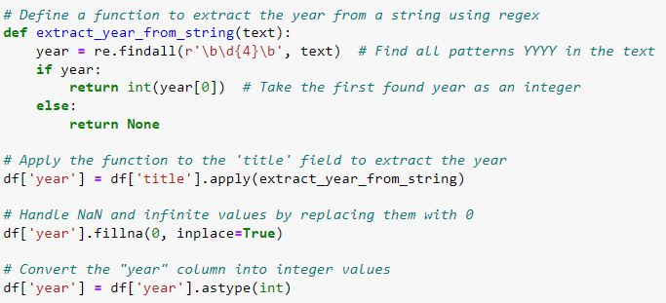
Extraction of the year from title
As I mentioned earlier, I extract the year using regular expressions and insert it into a new field called year .

Slide 10
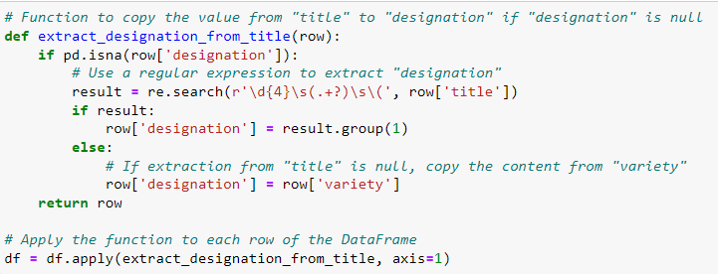
Retrieving missing values of designation
Ale retrieve missing values of designation from title can be done using regular expressions.
If the title field does not follow the structure " winery + year + designation + region 1 or province,“ a match with the commercial name to the variety (e.g., Nebbiolo, Pinot Gris, Chardonnay) can be attempted, without compromising the integrity of the information dramatically.

Slide 11
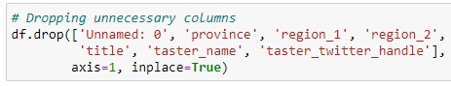
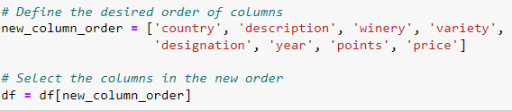
Deleting and reordering fields
I will delete the non-essential fields and reorder them for easier reading.

Slide 12
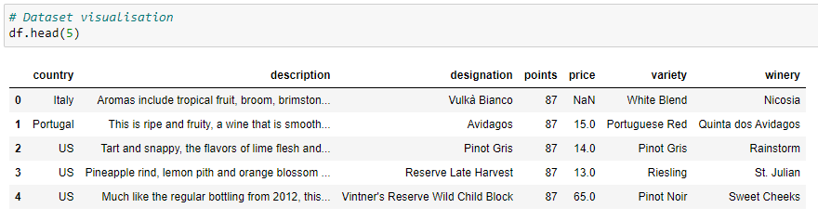
Dataset after cleaning

Slide 13
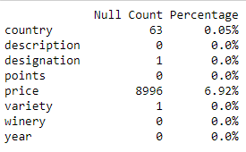
Dataset after cleaning
Checking the null fields after the cleaning operations reveals an empty record in the designation likely linked to the empty record in variety.

Slide 14
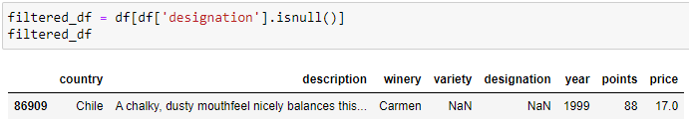
Record with empty variety

Slide 15
Deleting records with price and designation nulls
As expected the only record with no designation value left is one that doesn't even have values in variety , making it impossible to characterize.
Finally, I eliminated all the lines that have empty fields in price and designation, which are two fundamental fields for preparing the catalogue.

Slide 16
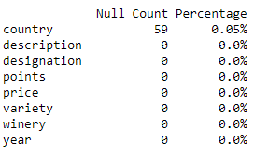
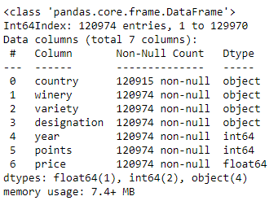
Dataset after cleaning is complete
At the end of the Data Cleaning phase, there are no empty values in the fundamental fields.
The country field is an important field but eliminating these 59 wines whose price and known commercial name, would result in an unnecessary loss of wines from the catalogue.

Slide 17
Description of the dataset
FIELD | DESCRIPTION
Country | Winery Nation
Description | Description of the wine
Designation | Commercial name of the wine
Points | Wine score between 80 and 100
Price | Price of wine
Variety | Variety of wine
Winery | Name of the winery
Year | Year of foundation of the winery

Slide 18
Data Analysis and Visualisation

Slide 19

Analysis to be carried out
Through graphs and tables I will try to carry out the following analyses.
Distribution of scores
Price distribution
Ranking of wines by country
Ranking of wine varieties by country
Ranking of wines based on average score
Ranking of wines based on average price
Price-quality correlation
Ranking of the most expensive wines
Excellence ranking
Ranking of wines by variety
Ranking of wine varieties by country

Slide 20
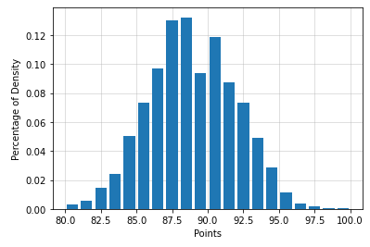
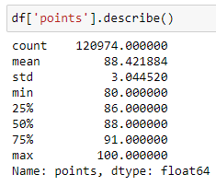
Distribution of scores
As a first graph, you can observe how the set of scores is distributed, which falls within the range of 80 and 100.
The obtained distribution curve is close to that of a Gaussian curve with the mean coinciding with the median.

Slide 21
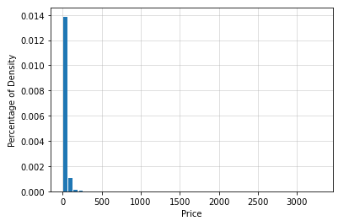
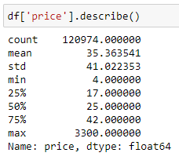
Price distribution - 1
Unlike scores, prices are spread over a much wider range. A density peak can be observed, but in this representation, it is not very clear.
The describe method suggests the presence of outliers. In fact, the highest price which is €3300, is far from the average value of €35.

Slide 22
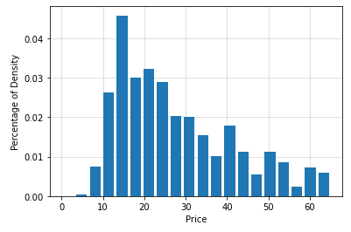
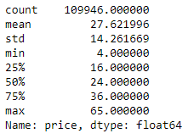
Price distribution - 2
I calculated the position of the 90th percentile, i.e. the price within which 90% of the products are included, and redrawn the graph considering this upper limit.
The 90th percentile is €65 and the mean is slightly higher than the median, showing a distribution with slight positive asymmetry.

Slide 23
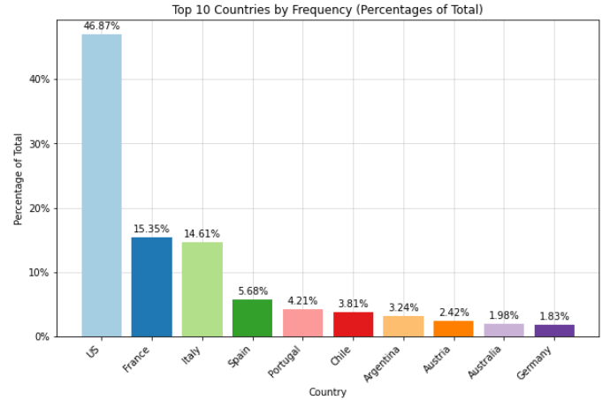
Ranking of wines by country
By grouping the dataset based on the country field, you can observe that the most represented country in the dataset is only the United States.
This implies that there are numerous commercial products of US origin available on the market; more than three times as many as French or Italian products.

Slide 24
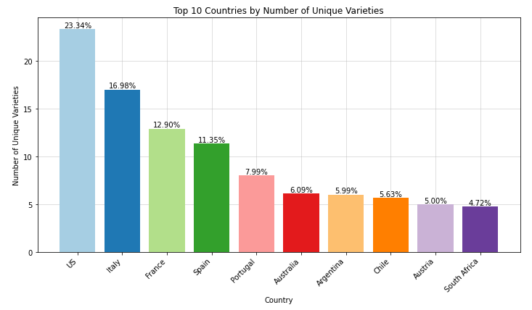
Ranking of wine varieties by country
When grouping the dataset based on the country field, you can observe that the most represented variety in the dataset is still the United States, although, with a smaller gap compared to the countries that follow.
By integrating the information from this graph with the previous one, it becomes evident that the United States sells each variety of wine, on average, with more commercial names than other countries.

Slide 25
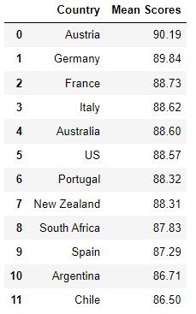
Ranking of wines based on average scores
Grouping of the wines based on the average points reveals that the first country in the ranking is Austria followed by Germany and France.
However, this data does not allow us to significantly discriminate between countries, because the differences between the positions are in the order of tenths.

Slide 26
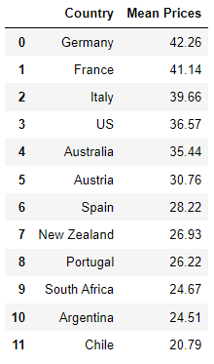
Ranking of wines based on average price
In preparation for a price-score correlation analysis, I enquired how the two rankings present the same countries but in a different order.
There is a more significant gap between the first and tenth position, which turns out to have an average price less than half lower than the first in the ranking.
The search was limited to countries with at least 1,000 wines.

Slide 27
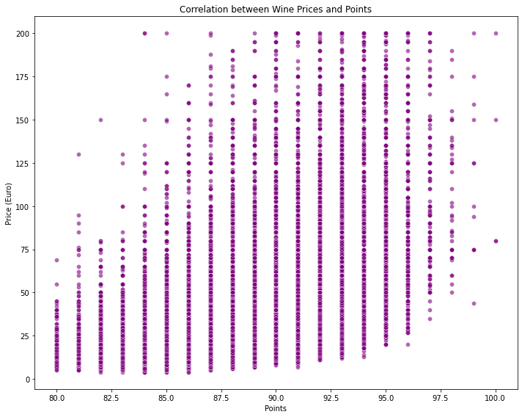
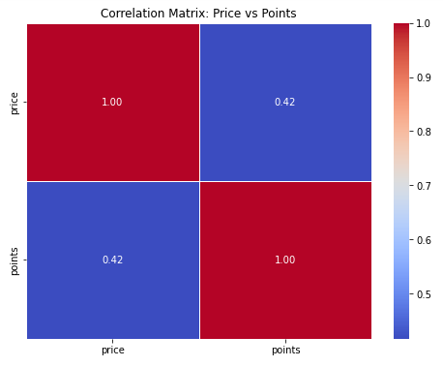
Price-quality correlation
Using the wine score as an indicator of quality and graphing the price trend as the score increases, you can observe a moderate positive correlation (0.42 on a scale of -1 to 1).
The graph illustrates the scarcity of expensive wines for low qualities and the scarcity of cheap wines for high qualities.

Slide 28
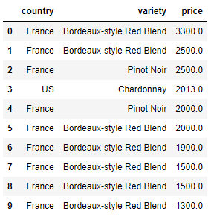
Ranking of the most expensive wines
Very interesting for commercial purposes is understanding which are the most expensive wines on sale.
Among the 10 most expensive wines, 9 are French including the most expensive one, €3300, a good €800 more than the second.
Furthermore, among the top 10 wines, 7 are of the Bordeaux variety.

Slide 29
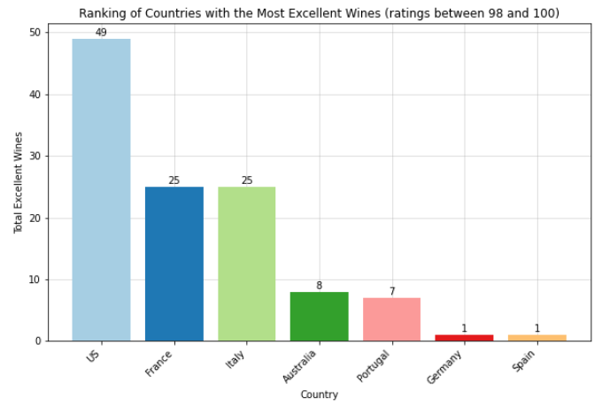
Excellence ranking
Much more interesting information can be obtained by searching for excellence.
By filtering the data based only on wines with scores between 98 and 100, once again, you can observe the presence of the United States, France, and Italy.
This ranking provides a better answer to the question of which countries produce the best wines.

Slide 30
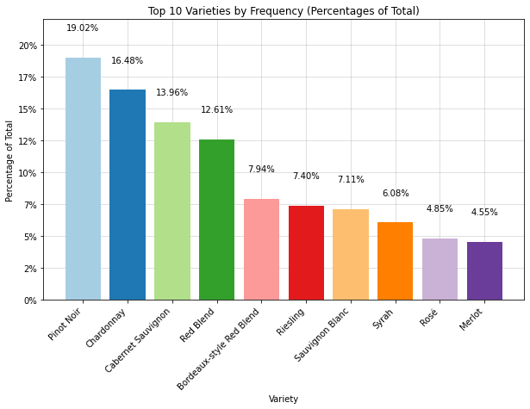
Ranking of wines by variety
The most represented and probably best-selling varieties are Pinot Noir, Chardonnay and Cabernet Sauvignon wines.

Slide 31
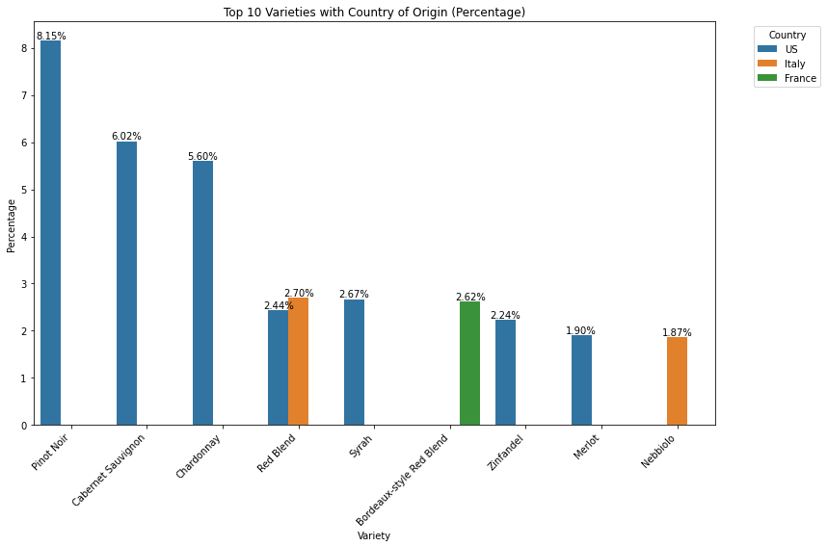
Ranking of wine varieties by country
The most represented and likely best-selling varieties are American, Italian, and French wines, with the United States once again taking the lead.

Slide 32
Key findings
The United States has, against the common perception, the broadest wine variety and the highest number of excellences.
Excluding the most expensive wines, the average price of a wine bottle is €27.
There is only a moderate correlation between wine quality and price.
The most expensive wines are French.
The most common wine is Pinot Noir.

Slide 33
Creation of the Catalogue

Slide 34
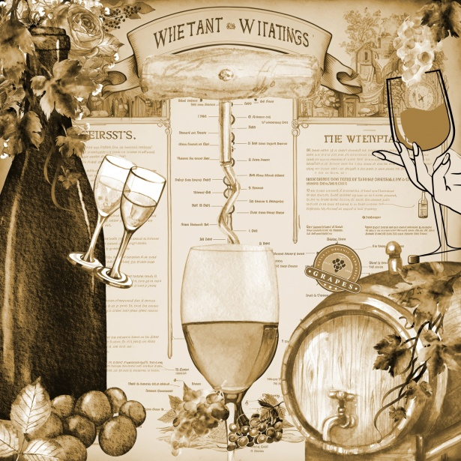
Catalogue creation
Based on the analysis, I created the catalogue by selecting the top 50 wines with the highest quality priced within €100.
The chosen strategy aims to combine high-quality wines at prices in line with the purchasing power of a large portion of potential customers.
The catalogue can be viewed on my Github repository .

